Slide 1

Video game analysis
An Effort by:-
Team Number 21

Slide 2
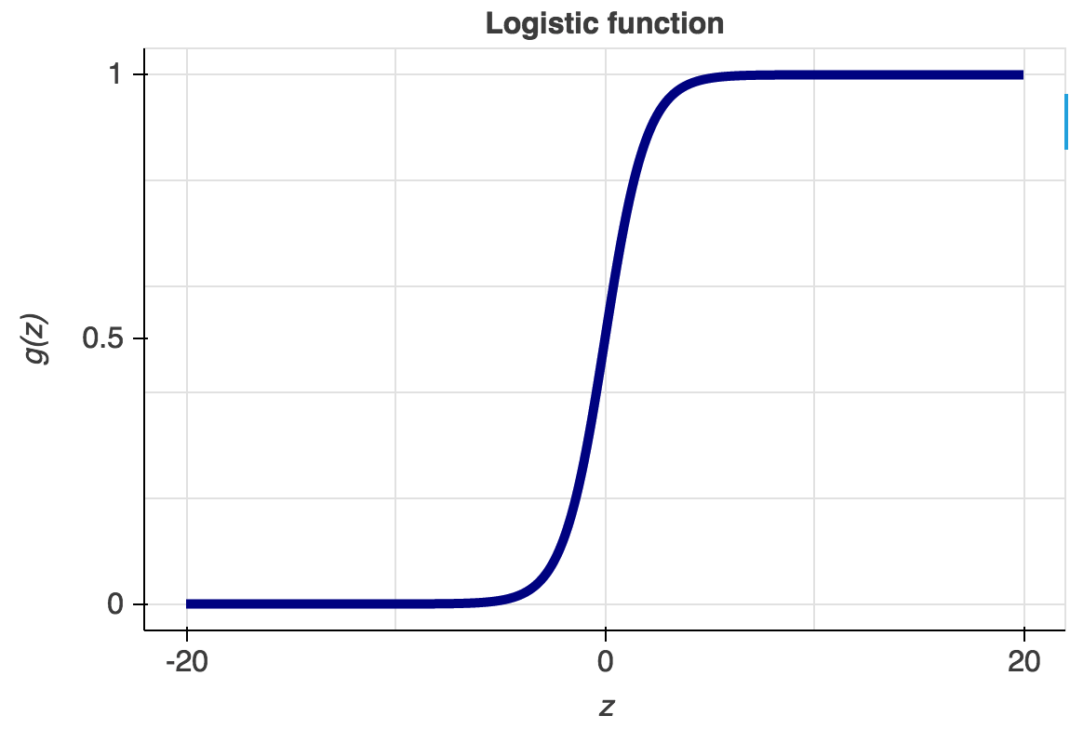
Prediction
We have used logistic Regression, to predict whether a game can still be a HIT.
Idea behind this is to predict which game goes on sale through different distribution channels.

Slide 3
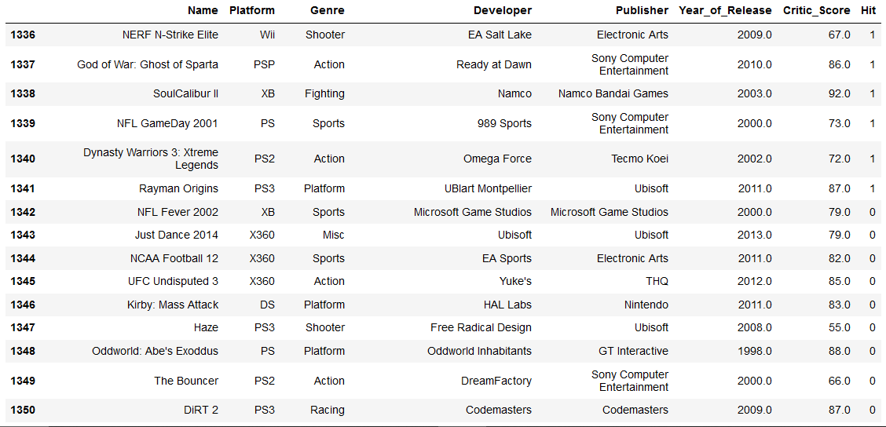
Hit used as target variable.

Slide 4
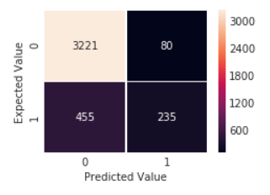
Confusion Matrix

Slide 5
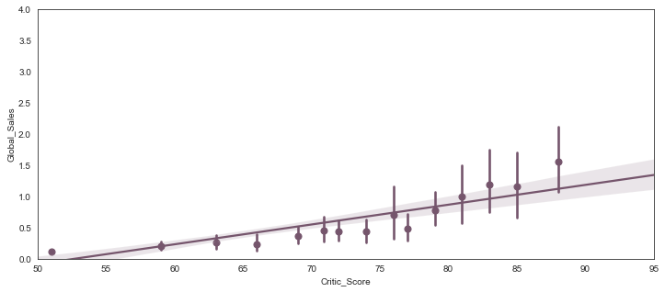
Regplot between sales and critic scores

Slide 6
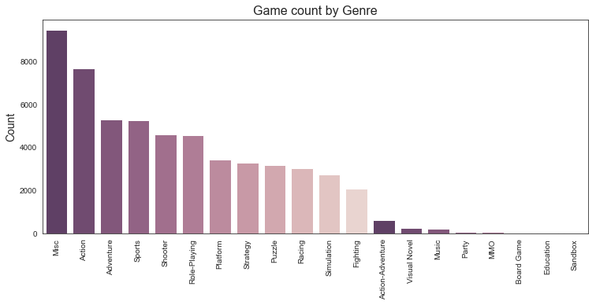

Slide 7
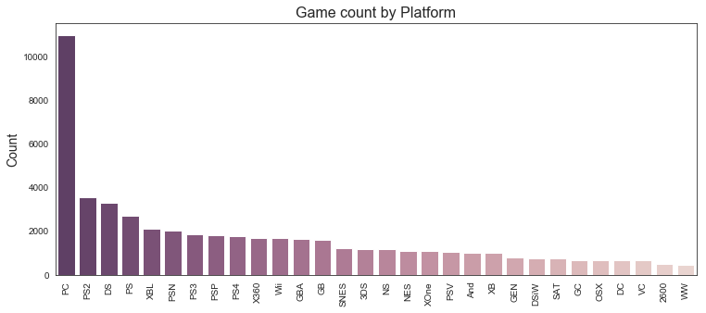

Slide 8
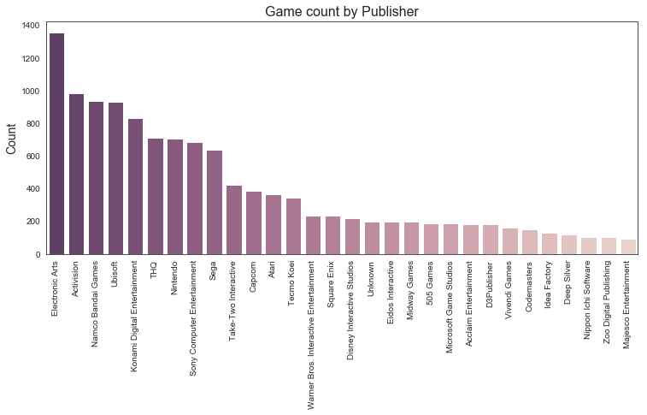

Slide 9
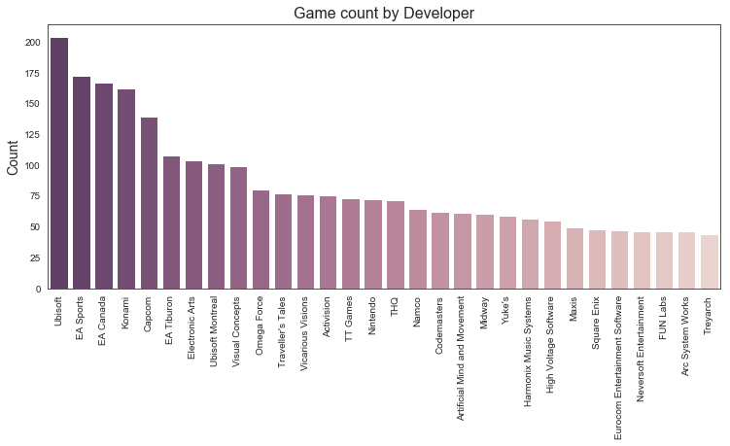

Slide 10
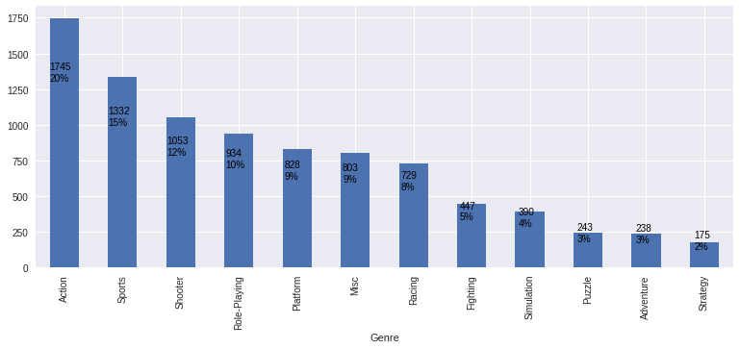
Sales

Slide 11
Recommendation
To build our model, we created count matrix by using count CountVectorizer.
Cosine similarity, to determine how similar documents are, irrespective of their size.

Slide 12
Contents
Working on the data.
Gloryplay
ucommend

